Slide 1
Getting stared with R and R Studio
Getting Started with R provides an overview of why R will be the core focus for this website. Alongside how to install R and R-Studio on your computer.
Basics of R Programming
R Basics introduces R-Studio and some core coding principles required for performance analysis.
Exploring StatsBomb Data Sets
This section provides an overview of some free StatsBomb data sets which can be used to develop your data analytics skills.
Data Visualization
Data Visualization provides some core ideas on data visualizations, focusing on using ggplots2 and football examples.

Slide 2
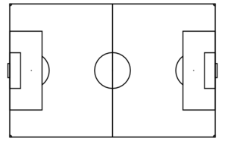

SPORT
DATA
ANALYTICS

